Slide 1
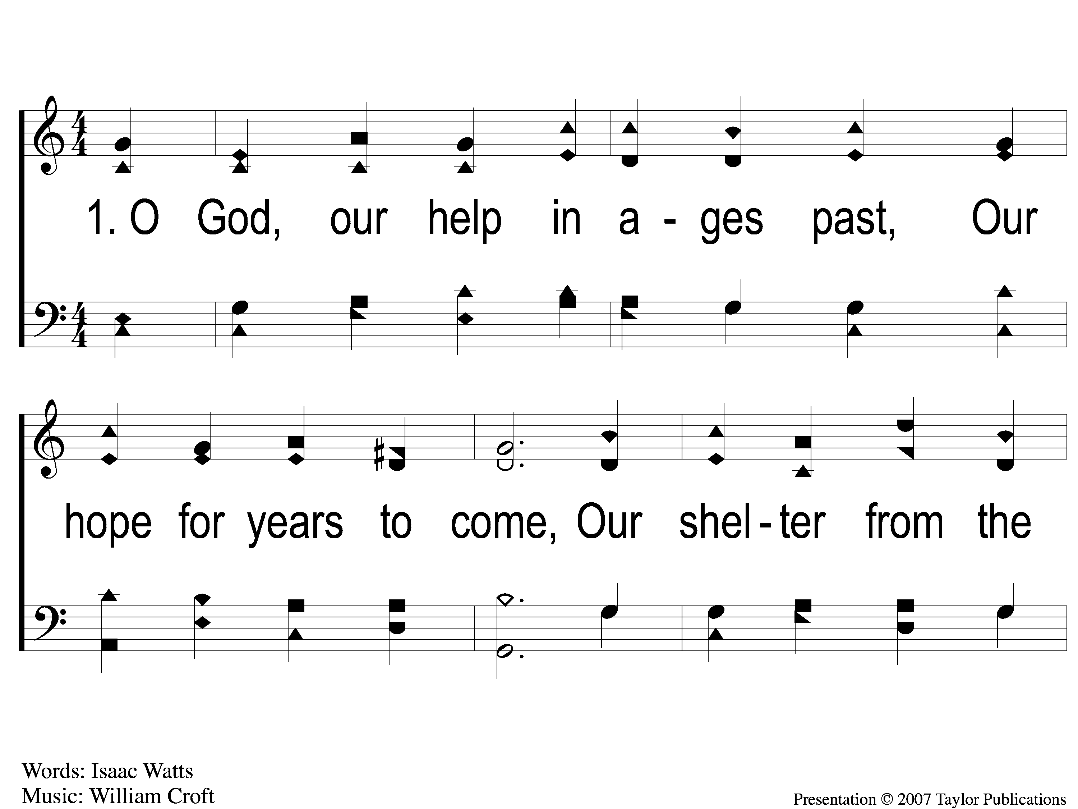
1-1 O God our Help in Ages
O God, Our Help In Ages Past
140b

Slide 2
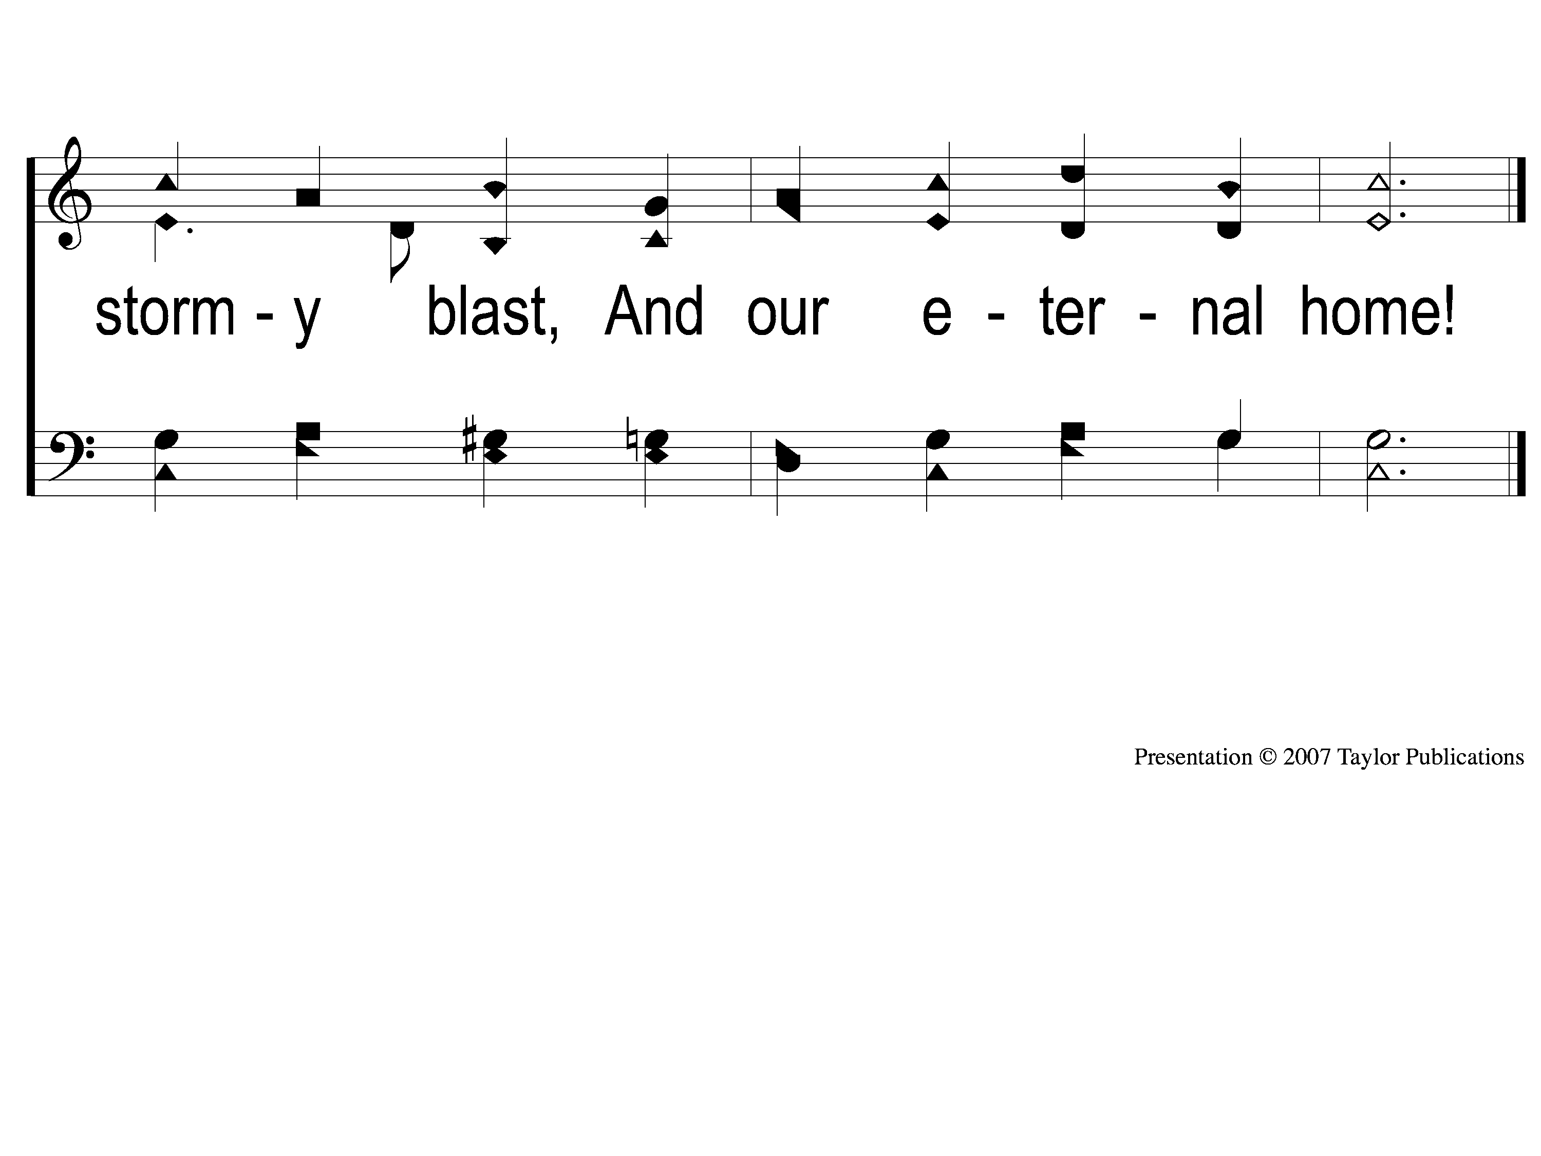
1-2 O God our Help in Ages
O God, Our Help In Ages Past
140b

Slide 3
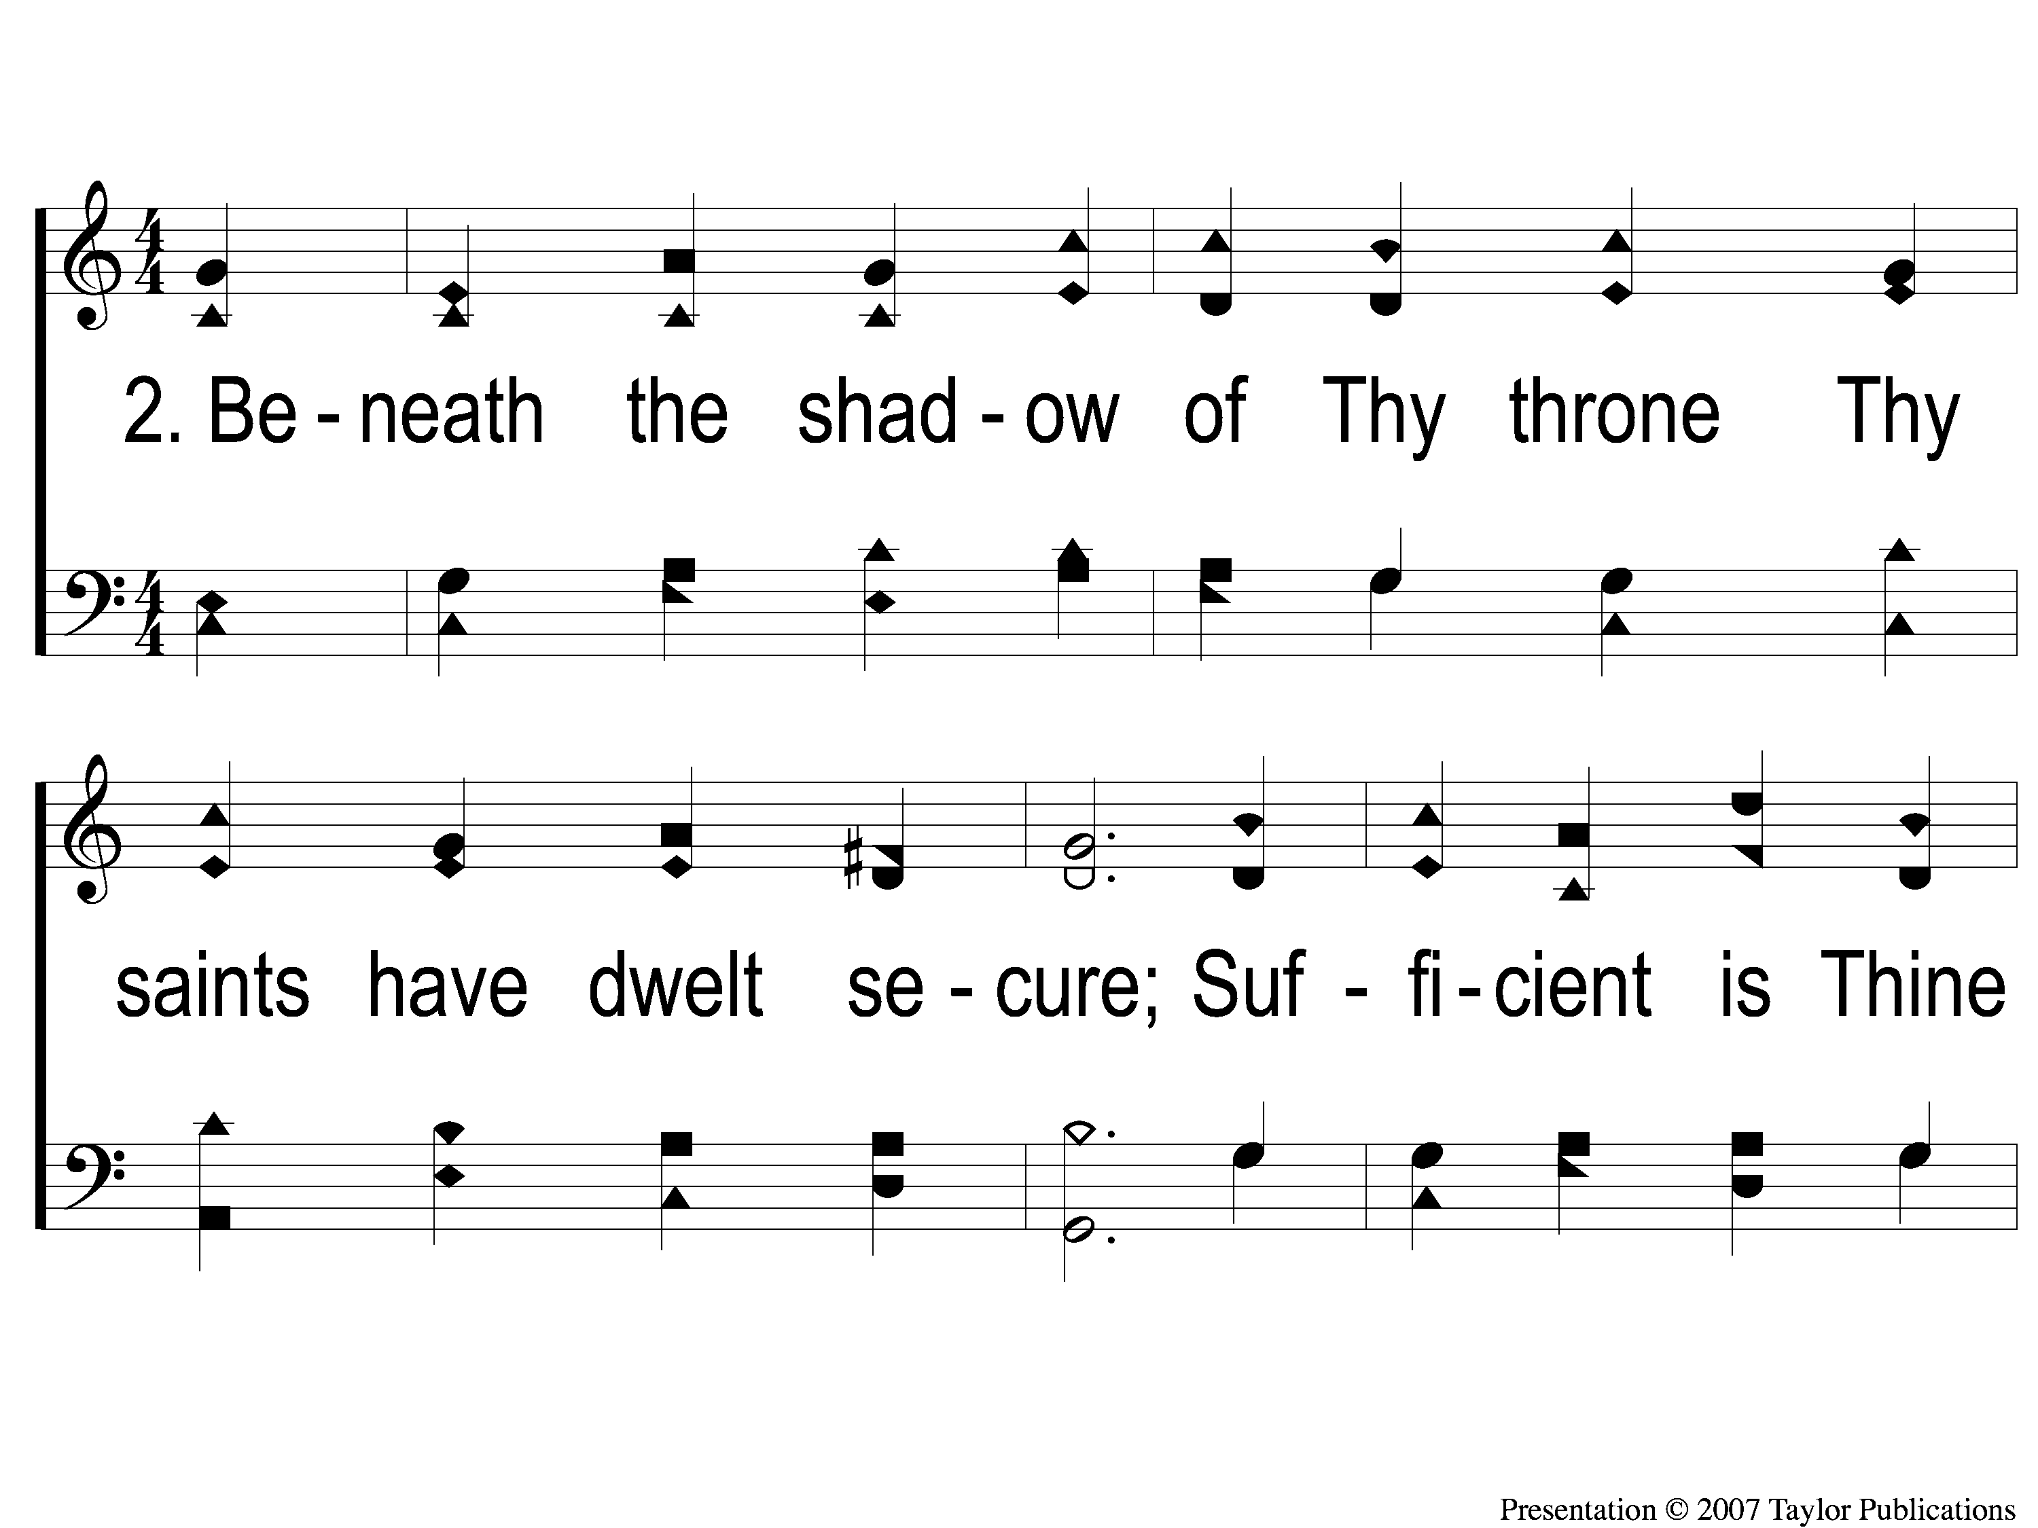
2-1 O God our Help in Ages
O God, Our Help In Ages Past
140b

Slide 4
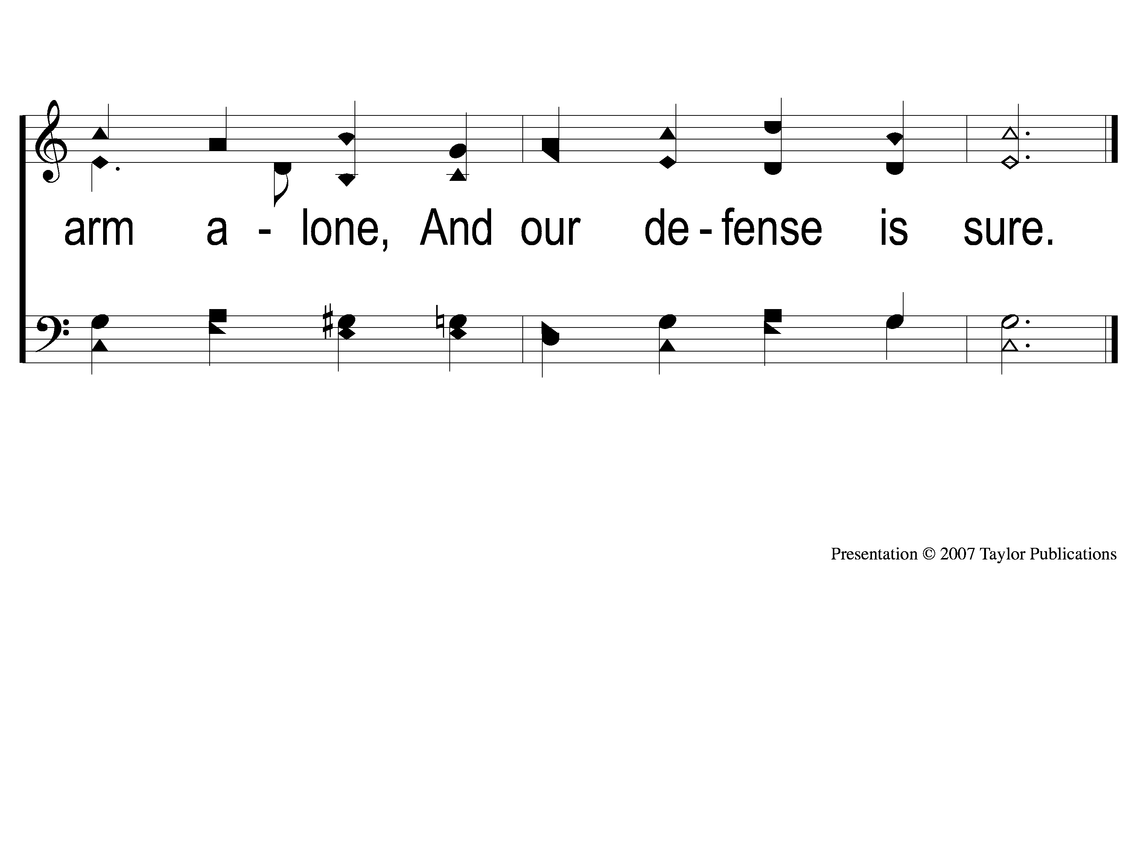
2-2 O God our Help in Ages
O God, Our Help In Ages Past
140b

Slide 5
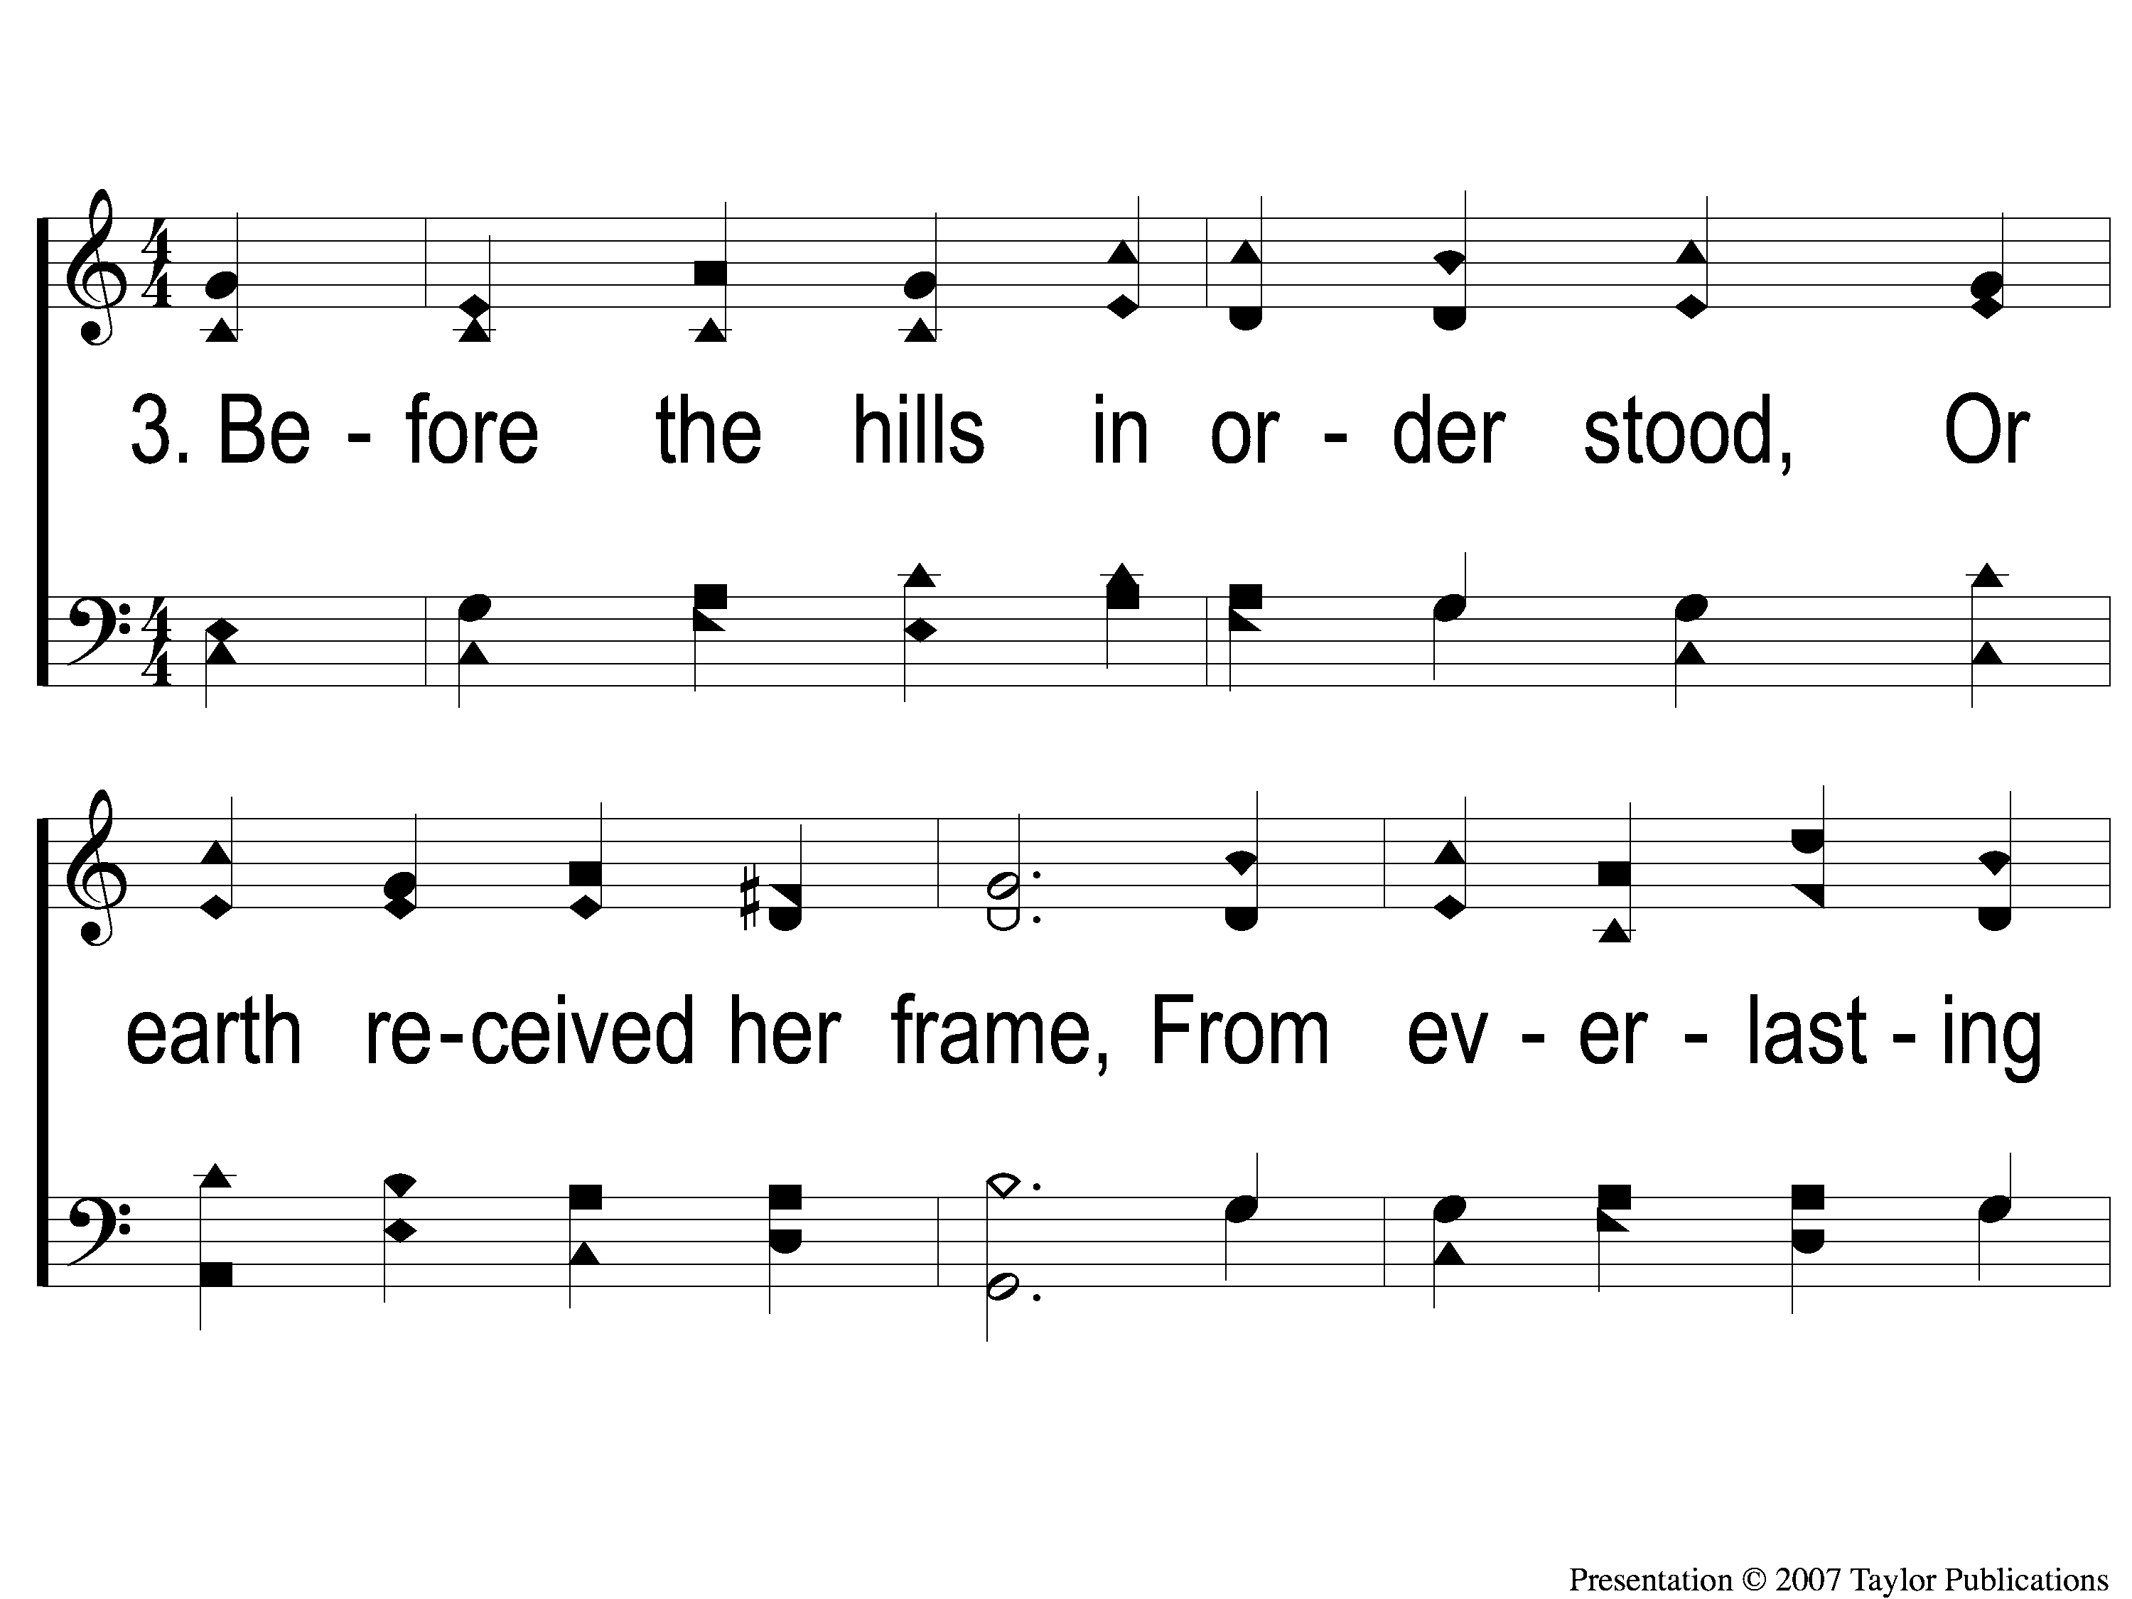
3-1 O God our Help in Ages
O God, Our Help In Ages Past
140b

Slide 6
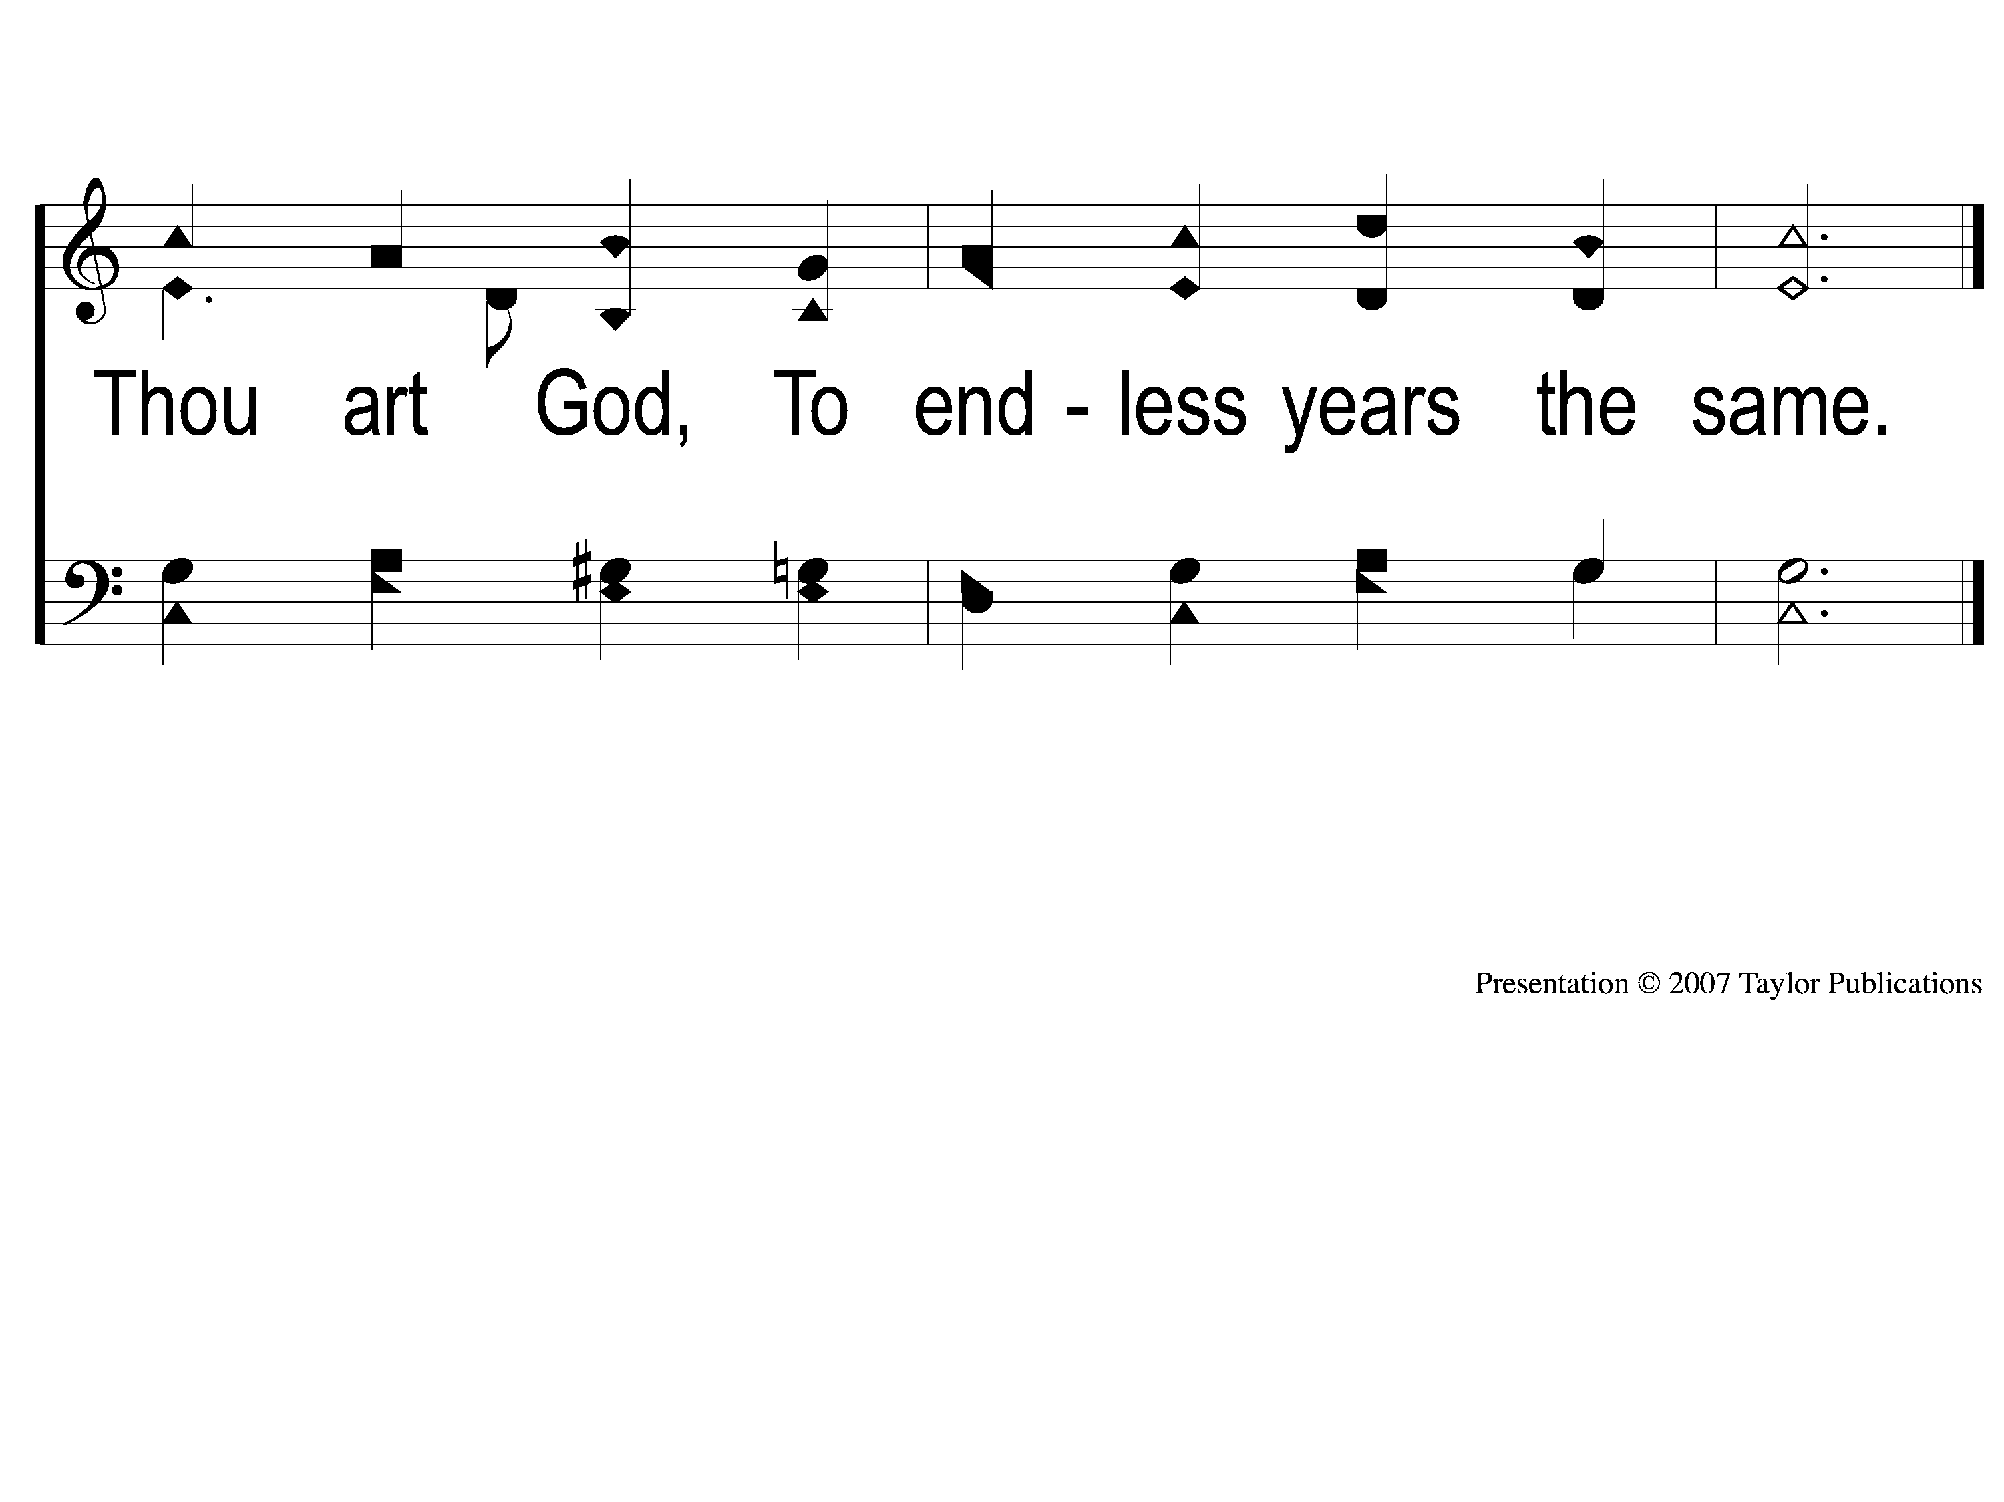
3-2 O God our Help in Ages
O God, Our Help In Ages Past
140b

Slide 7
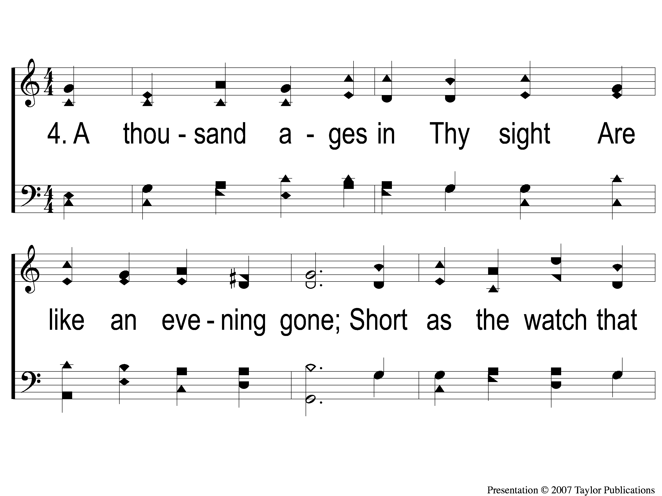
4-1 O God our Help in Ages
O God, Our Help In Ages Past
140b

Slide 8
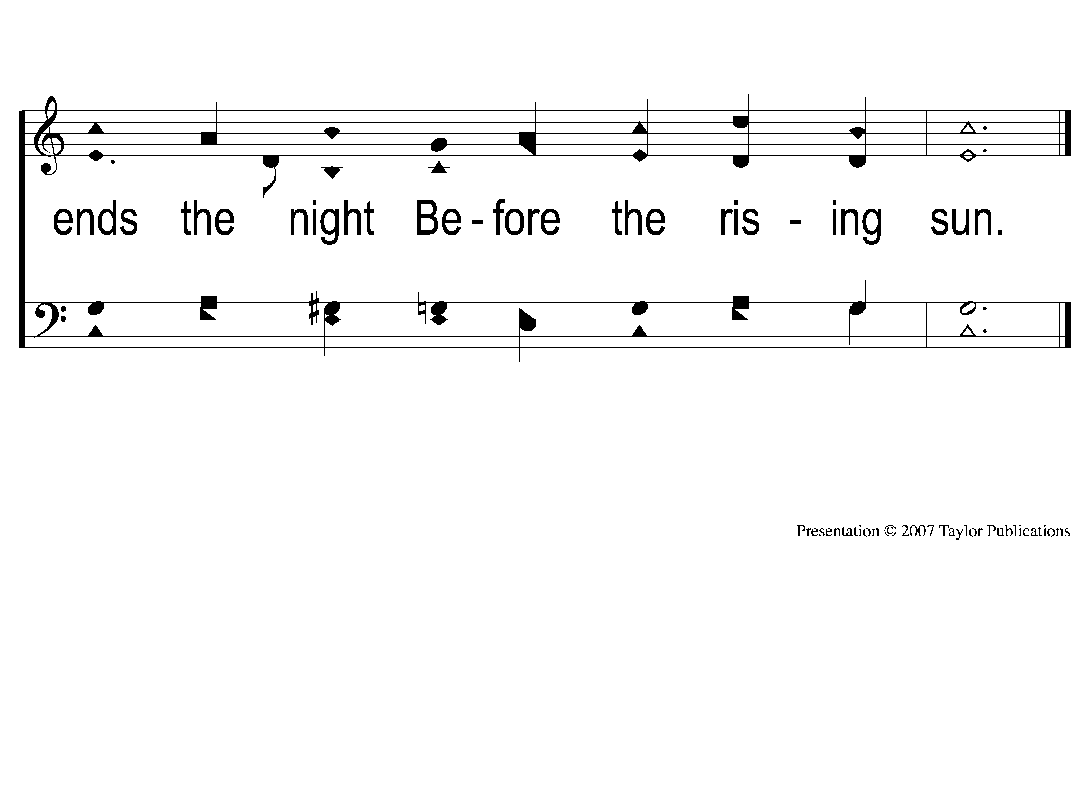
4-2 O God our Help in Ages
O God, Our Help In Ages Past
140b

Slide 9
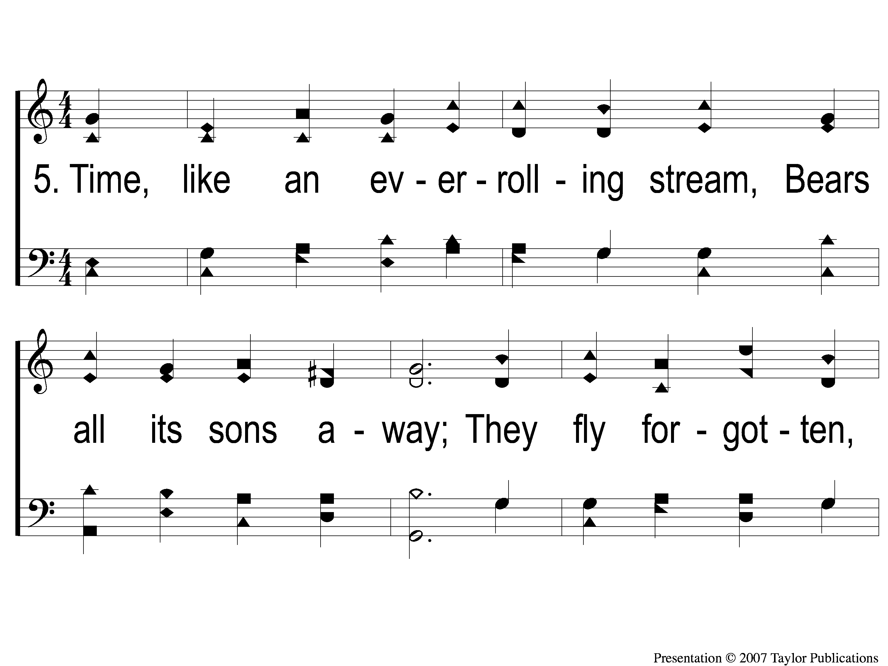
5-1 O God our Help in Ages
O God, Our Help In Ages Past
140b

Slide 10
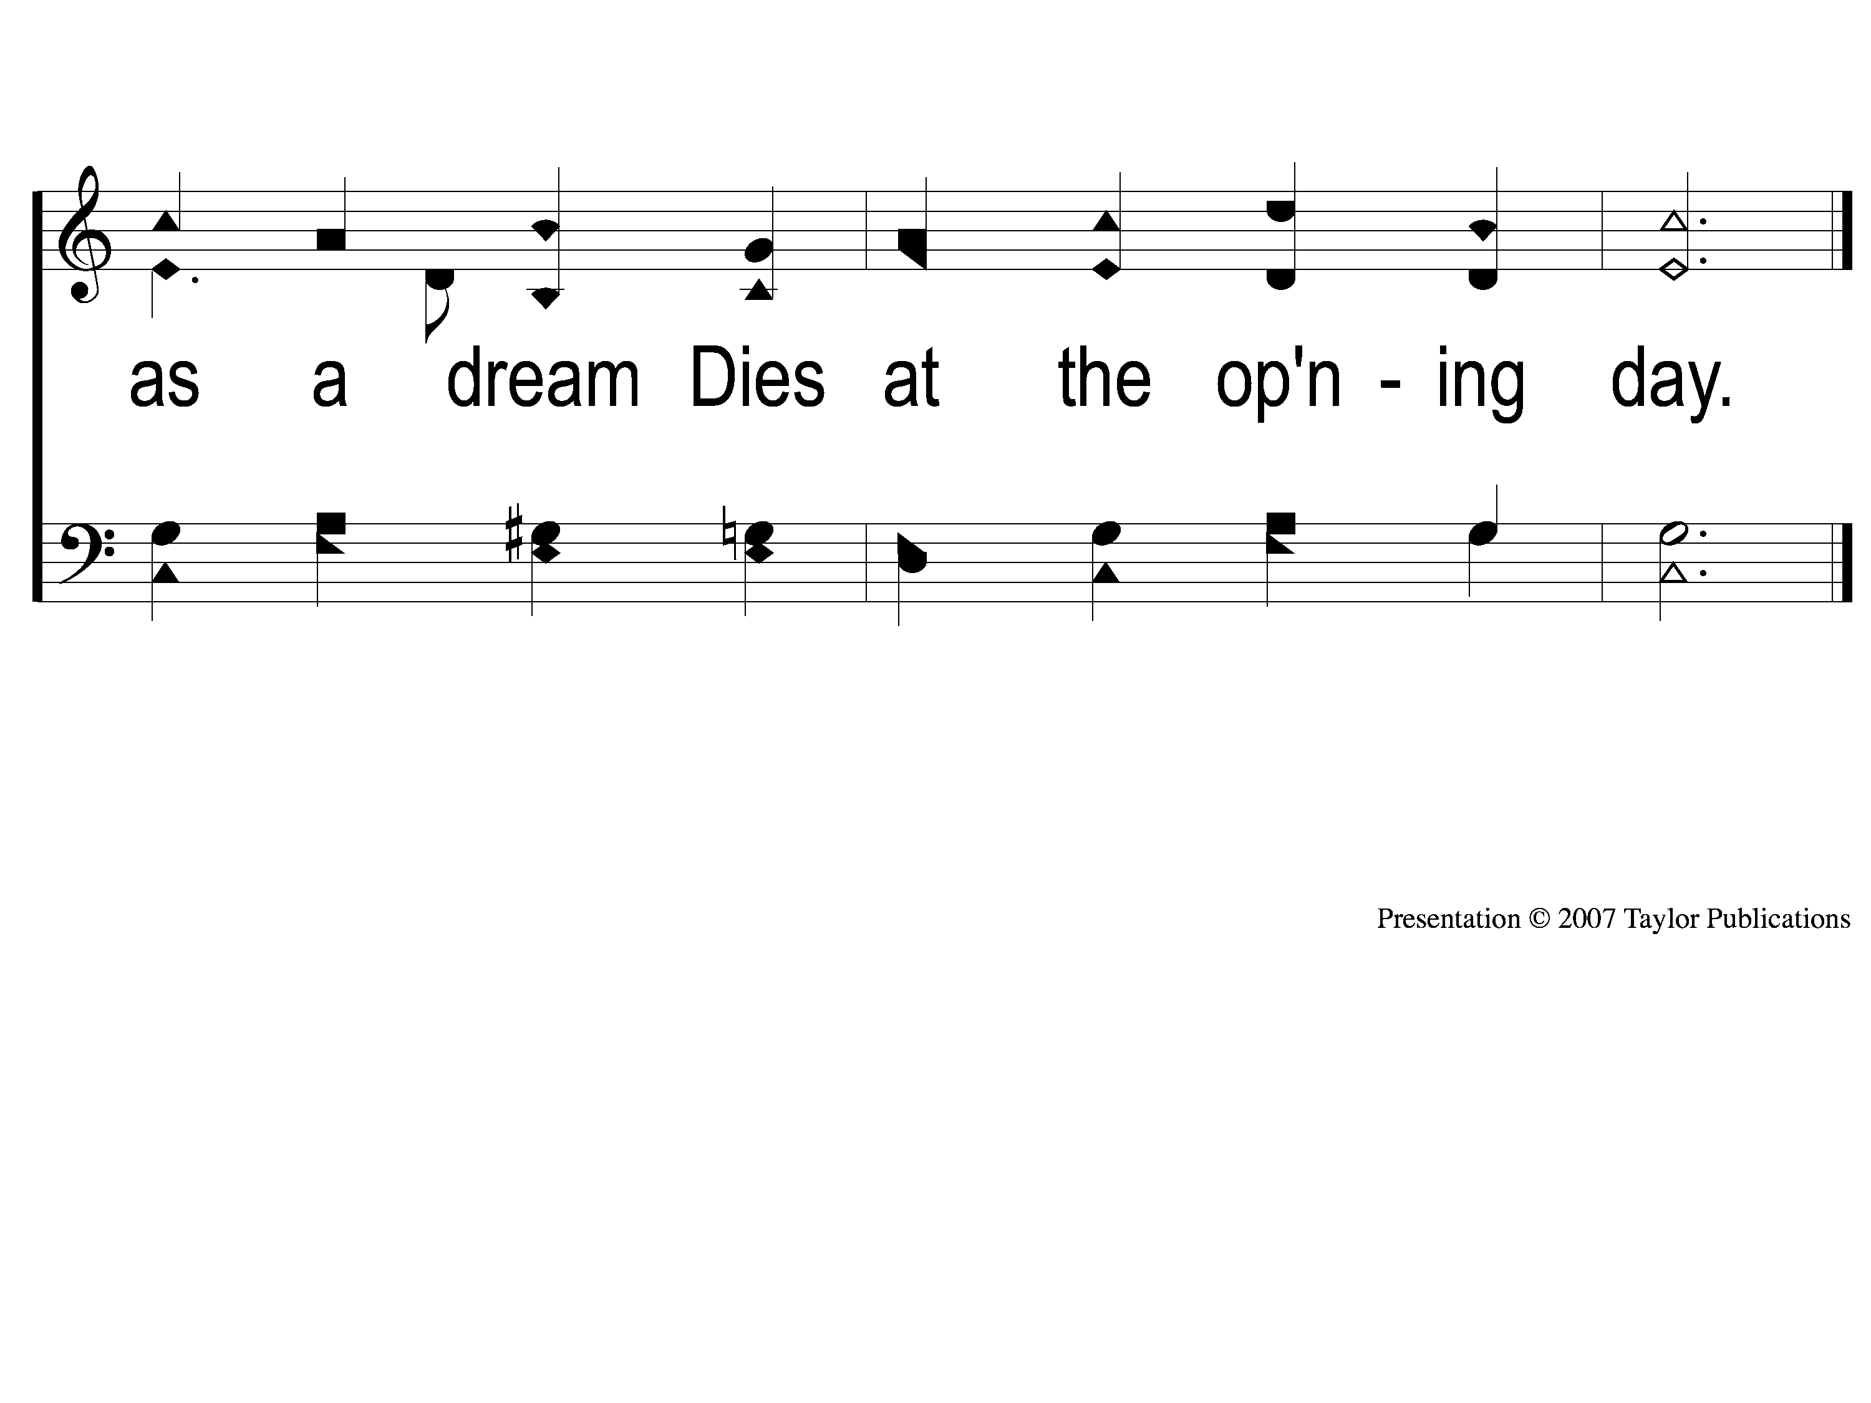
5-2 O God our Help in Ages
O God, Our Help In Ages Past
140b

Slide 11
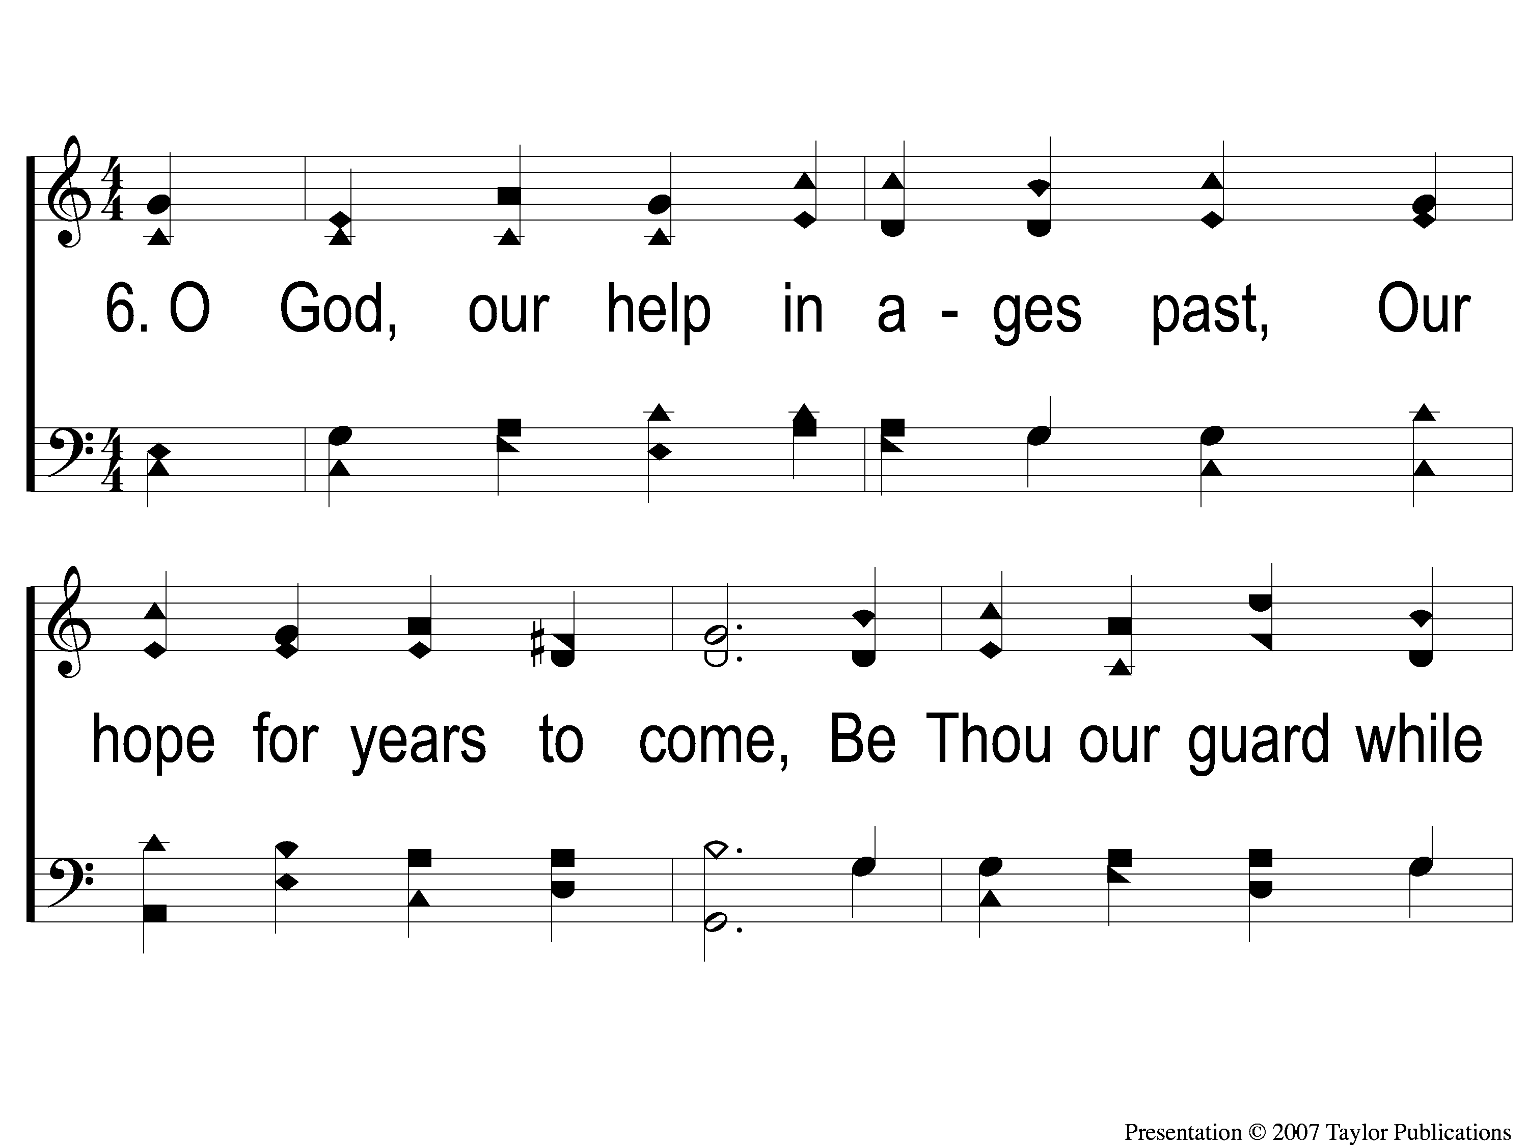
6-1 O God our Help in Ages
O God, Our Help In Ages Past
140b

Slide 12
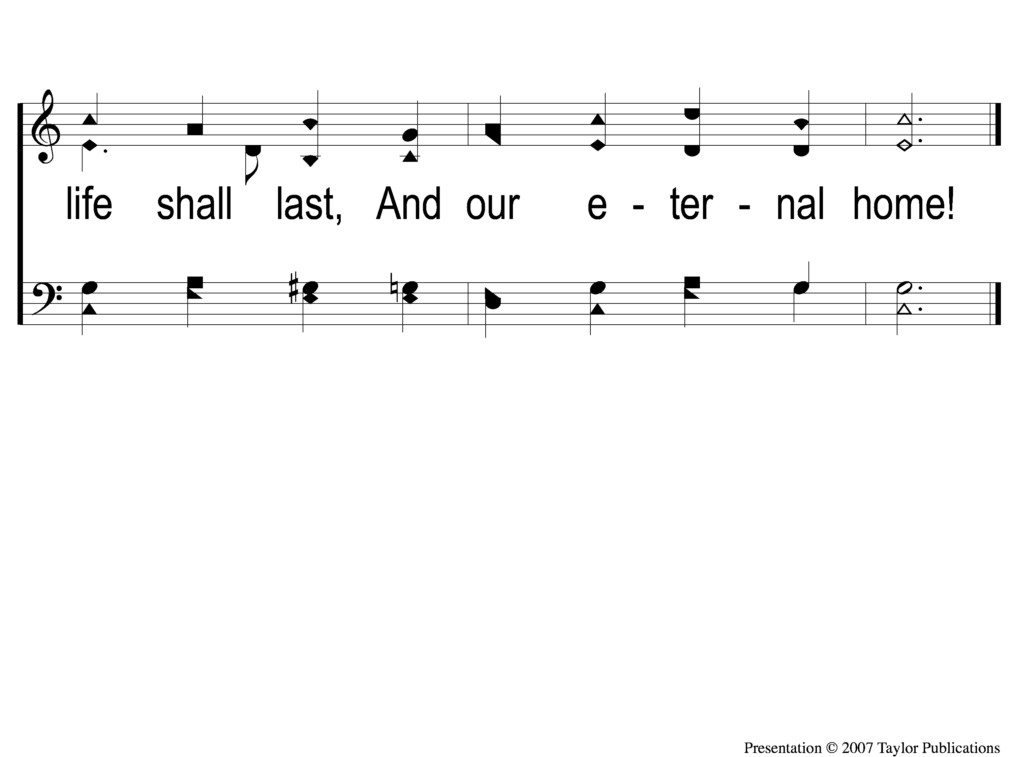
6-2 O God our Help in Ages
O God, Our Help In Ages Past
140b

